Slide 1
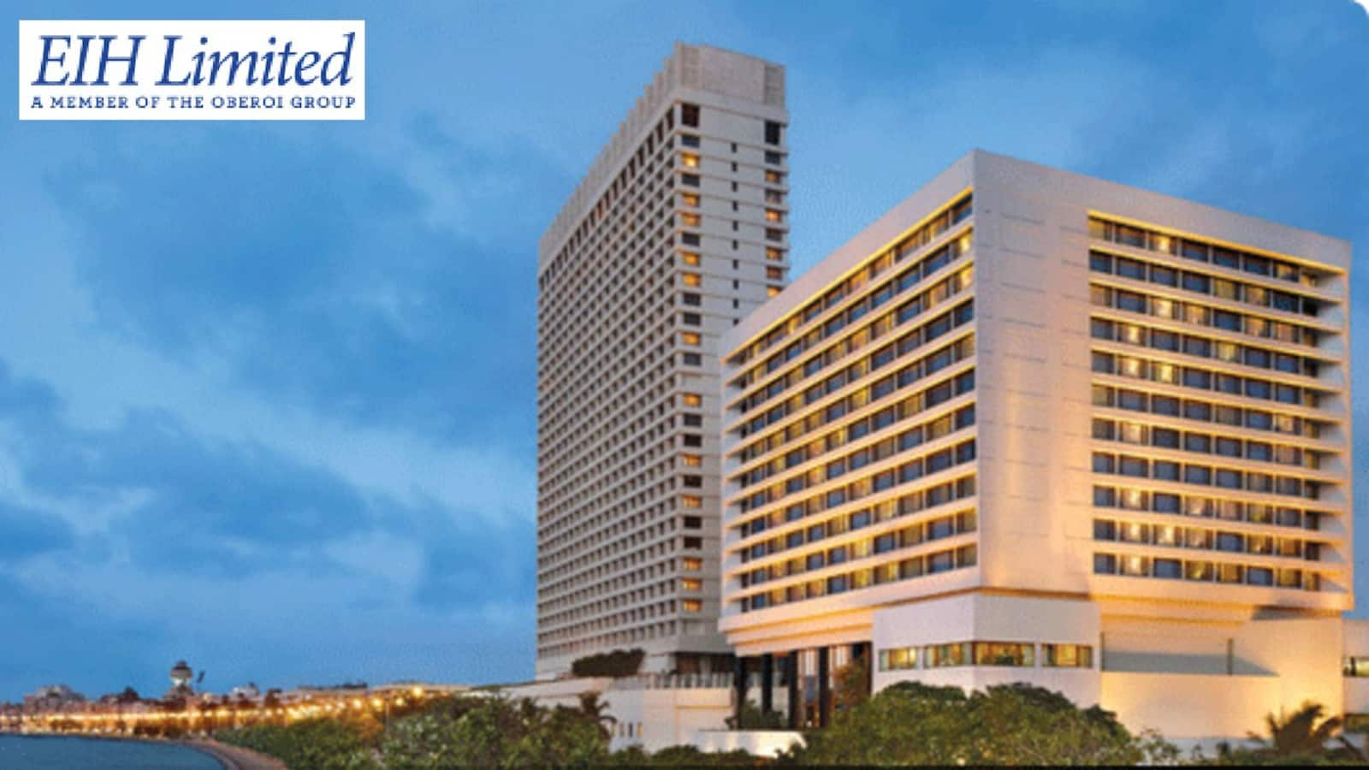
By : Priya Jha

Slide 2

Agenda
EIH HOTELS PRESENTATION
About the Company
Company Leadership
Hotel Brands
Competitor Analysis
Company Financial Performance
Shareholdings

Slide 3
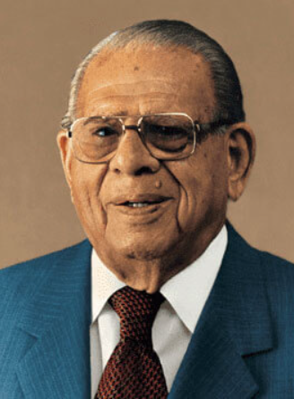
About the Company
EIH Limited is the flagship company of the Oberoi group, one of the largest luxury hotel chains in India.
They operate hotels under the 3 remote names – Oberoi, Trident & Maidens.
EIH Limited has 30 owned and managed hotels in 14+ locations covered which has 4269 rooms.
An entrepreneur, a visionary, a philanthropist
Mr. Rai Bahadur Mohan Singh Oberoi was born on August 15, 1898, in the erstwhile undivided Punjab.
He was barely six months old when his father passed away. He grew up under the love, guardianship and supervision of his grandfather, who made sure that he received the best education and upbringing.
He completed his primary education in Rawalpindi and moved to Lahore for his bachelor's degree.
Shortly thereafter, to flee the plague, he went to Shimla and found a job with a monthly salary of Rs. 50, as a front desk clerk at The Cecil Hotel, which The Oberoi Group acquired in 1944 and still owns today

Slide 4
Leadership
Arjun Singh Oberoi
Executive Chairman
Mr. Arjun Singh Oberoi is the Executive Chairman of EIH Limited. Mr. Arjun Singh Oberoi has been an Executive Director of the Company for over two decades and has over 30 years of experience in the hotel industry.
Mr. Arjun Singh Oberoi has a strong foundation in hotel operations dating back to the early part of his career. Mr. Arjun Singh Oberoi worked closely with Mr. PRS Oberoi to plan and develop many Oberoi and Trident Hotels.
In his previous role, he was responsible for the Project Development team of The Oberoi Group. He took on this role when he joined the Corporate Office of EIH Limited in 1996. He has been a member of The Oberoi Group and McKinsey & Company team responsible for re-engineering systems and processes within the food and beverage departments of “The Oberoi” city hotels.
Vikramjit Singh Oberoi
Managing Director and Chief Executive Officer
Mr. Vikramjit Singh Oberoi is the Managing Director and Chief Executive Officer of EIH Limited. He holds a Bachelor's degree in Science from Pepperdine University, California, USA and has over 25 years experience in the hospitality industry.
He joined the Board as a Non-Executive Director on 15th December, 1993. He became a Whole-time-Time Director and was designated Deputy Managing Director in July 2004.
In July 2007, he was re-designated as Joint Managing Director of the Company. On November 29th, 2010, he was re-designated Chief Operating Officer and Joint Managing Director of EIH Limited.
He took up the role of Managing Director and Chief Executive Officer on April 1st, 2015.

Slide 5
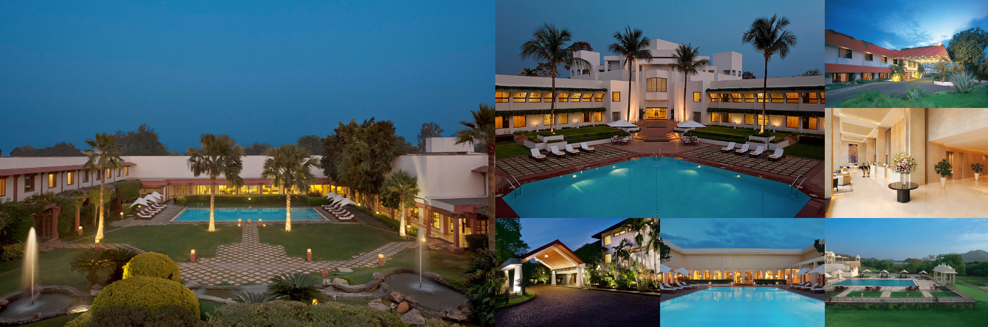
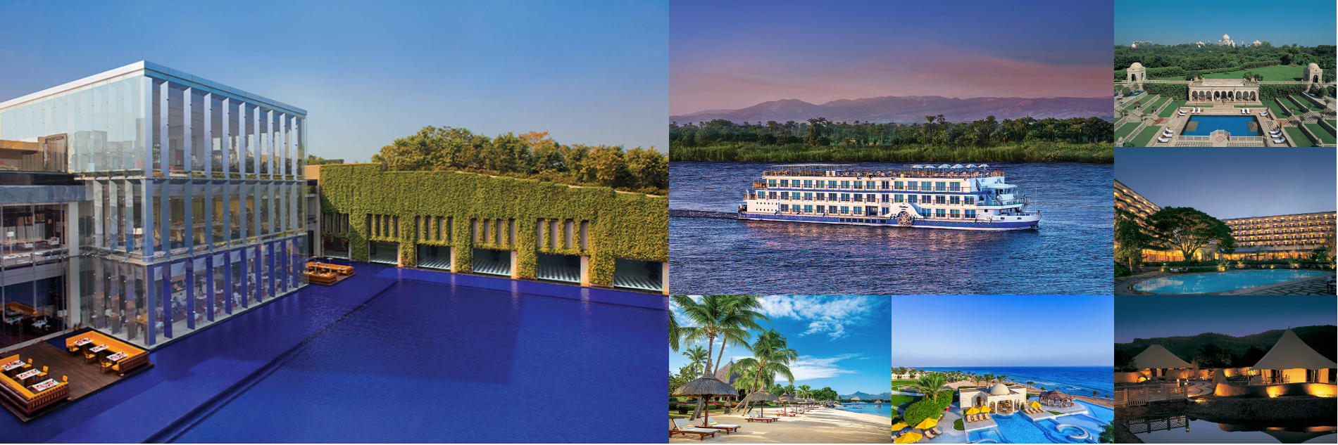
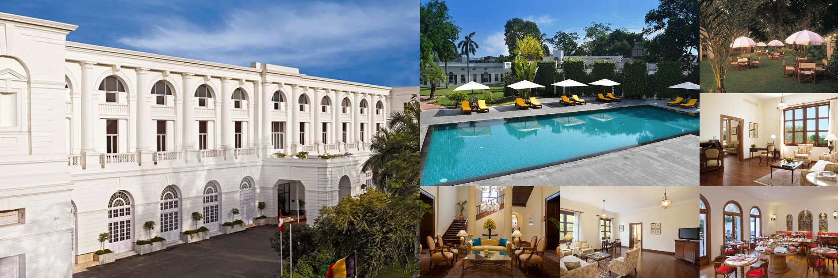
Hotel Brands
E I H
Oberoi
Maiden
Others
Trident
EIH Aviation (Air charter)
Airport Services like lounges, etc.
Flight Services (Catering)
Avis India (Car rentals)

Slide 6
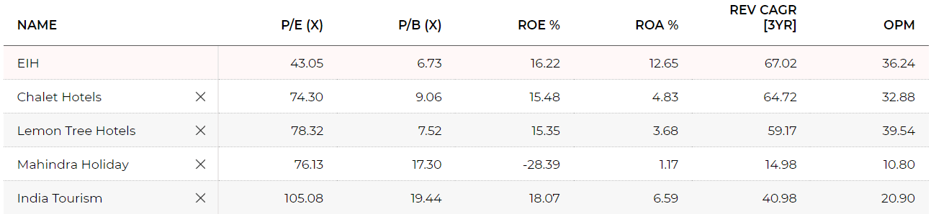
Competitor Analysis

Slide 7
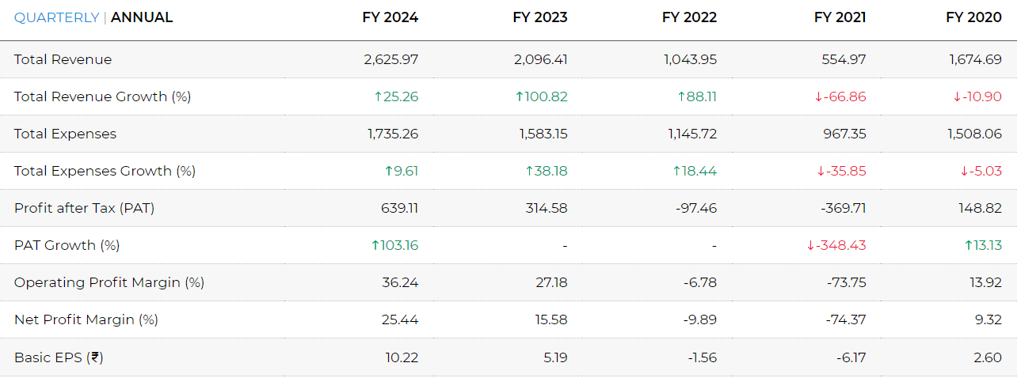
Company Financial Reports
P&L Statement

Slide 8
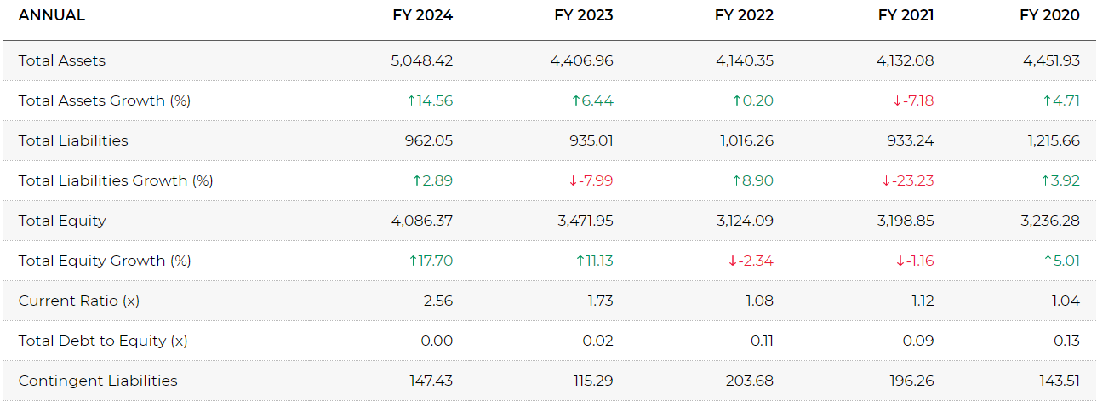
Company Financial Reports
Balance Sheet

Slide 9
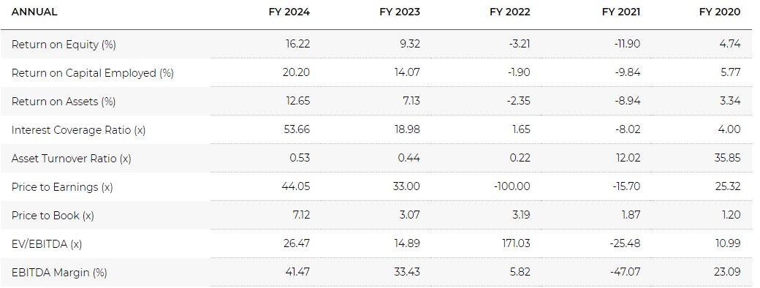
Company Financial Reports
Ratios

Slide 10
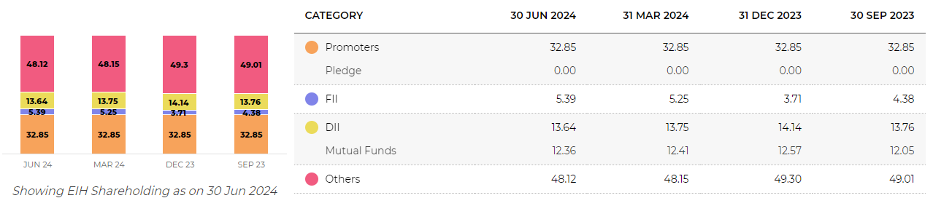
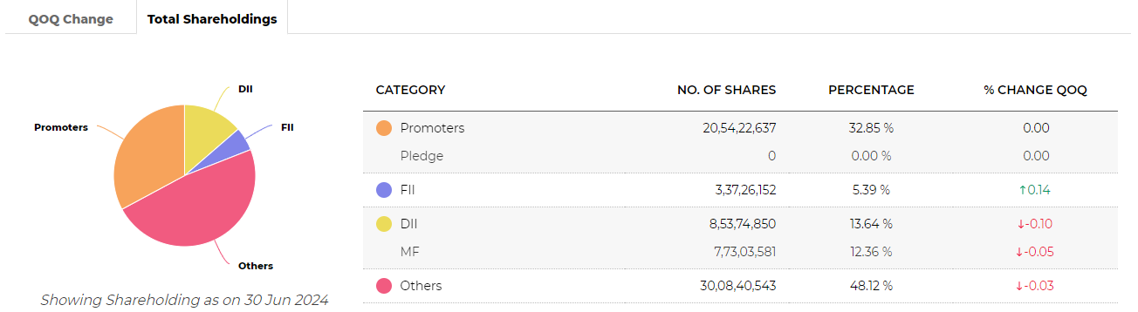
Shareholdings

